Slide 1


Network protocols & security
24EC2210
Topic:
TCP Connection Establishment & Release
Session - 26

Slide 2
TCP Connection Establishment

Slide 3
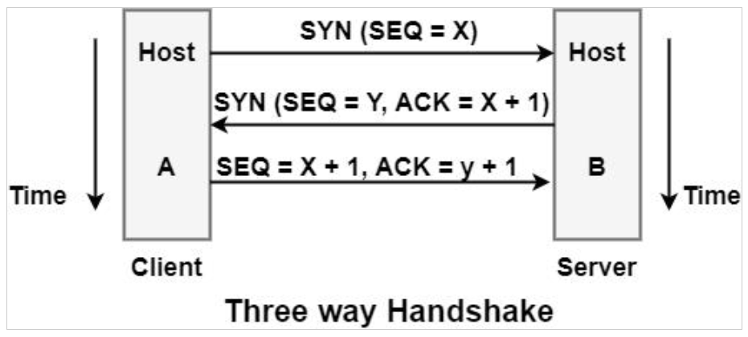
TCP Connection Establishment
Connection establishment is performed by using the three-way handshake mechanism.
A three-way handshake synchronizes both ends of a network by enabling both sides to agree upon original sequence numbers.

Slide 4
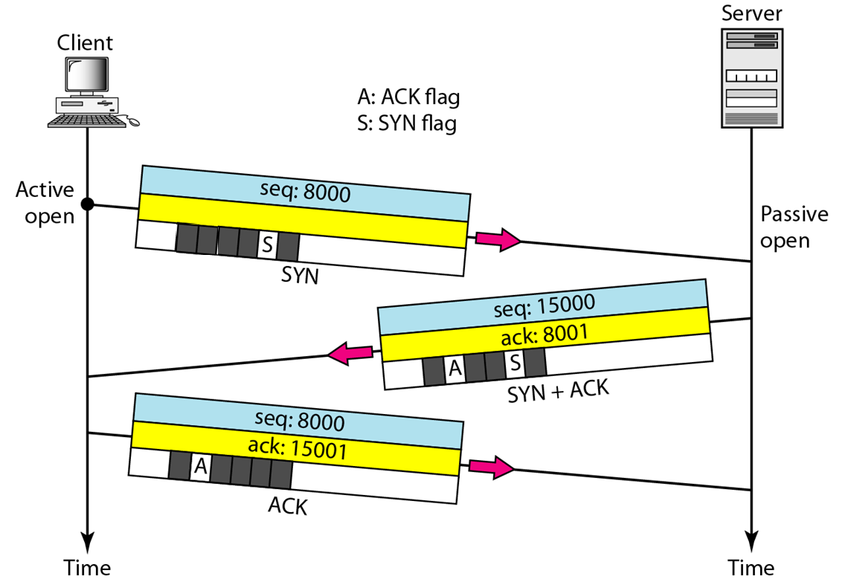
Three-way handshaking…
Step 1: SYN (Synchronize)
The client initiates the connection by sending a TCP segment with the SYN flag set to the server.
The client selects an initial sequence number for the connection, which is a randomly chosen value.
The SYN segment also includes the client's initial TCP window size, which indicates the number of bytes the client is willing to receive.

Slide 5
Three-way handshaking…
Step 2: SYN-ACK (Synchronize-Acknowledge)
Upon receiving the SYN segment from the client, the server responds with a TCP segment containing the SYN and ACK flags set.
The server selects its own initial sequence number for the connection.
The SYN-ACK segment also includes the server's initial TCP window size, acknowledging the client's window size from the previous step.
Additionally, the SYN-ACK segment may include other optional parameters negotiated between the client and server, such as maximum segment size (MSS) or TCP options.

Slide 6
Three-way handshaking…
Step 3: ACK (Acknowledge)
Finally, the client acknowledges the server's SYN-ACK segment by sending an ACK segment.
The ACK segment has the ACK flag set and contains the acknowledgment number, which is the server's initial sequence number incremented by one.
The client also confirms the server's TCP window size, indicating the number of bytes it is willing to receive from the server.
At this point, the connection is established, and both the client and server can begin transmitting data.

Slide 7

Note
A SYN segment cannot carry data, but it consumes one sequence number.
A SYN + ACK segment cannot carry data,
but does consume one sequence number.
An ACK segment, if carrying no data, consumes no sequence number.

Slide 8
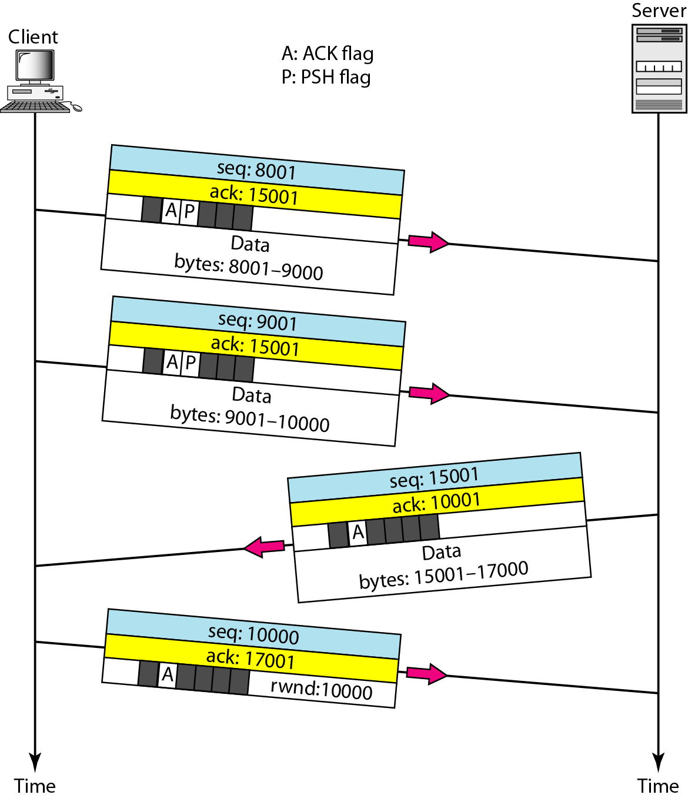
Figure 23.19 Data transfer

Slide 9
TCP Connection Release

Slide 10
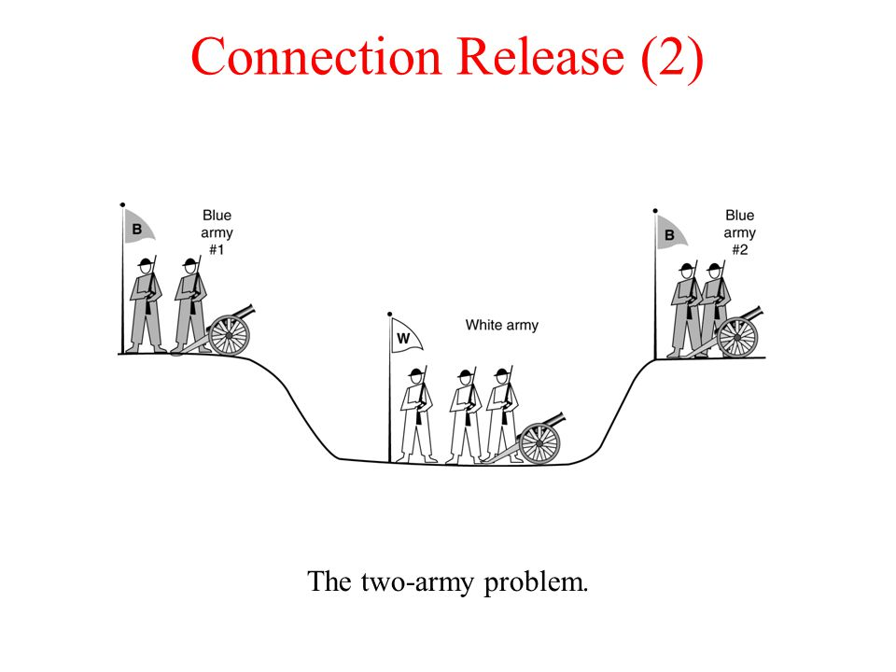
TCP Connection Release

Slide 11
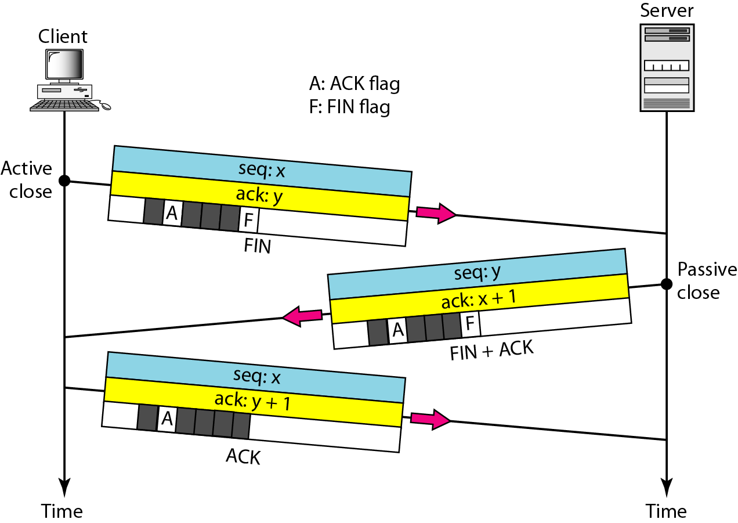
TCP Connection Release
TCP connection release is also performed using three-way handshake mechanism.

Slide 12
Note
The FIN segment consumes one sequence number if it does not carry data.

Slide 13
Note
The FIN + ACK segment consumes one sequence number if it does not carry data.

Slide 14
A TCP Connection Release
Step-1: Initiating the Connection Termination - The device that wishes to terminate the connection (active closer) sends a TCP segment with the FIN flag set to the other device, indicating its intention to close the connection.
Step-2: Acknowledgment and Finalizing the Connection Termination - Upon receiving the FIN segment, the receiving device (passive closer) acknowledges the termination request by sending an acknowledgment (ACK+FIN) TCP segment back to the active closer. This segment has the ACK and FIN flags set.
Step-3: Acknowledgment of the Final Termination - Upon receiving the FIN segment from the passive closer, the active closer acknowledges it by sending an ACK segment back. This ACK serves as confirmation that the passive closer's FIN has been received.
Now the connection between two parties is terminated.

Slide 15
THANK YOU
Team –Network Protocols and Security

